Slide 1
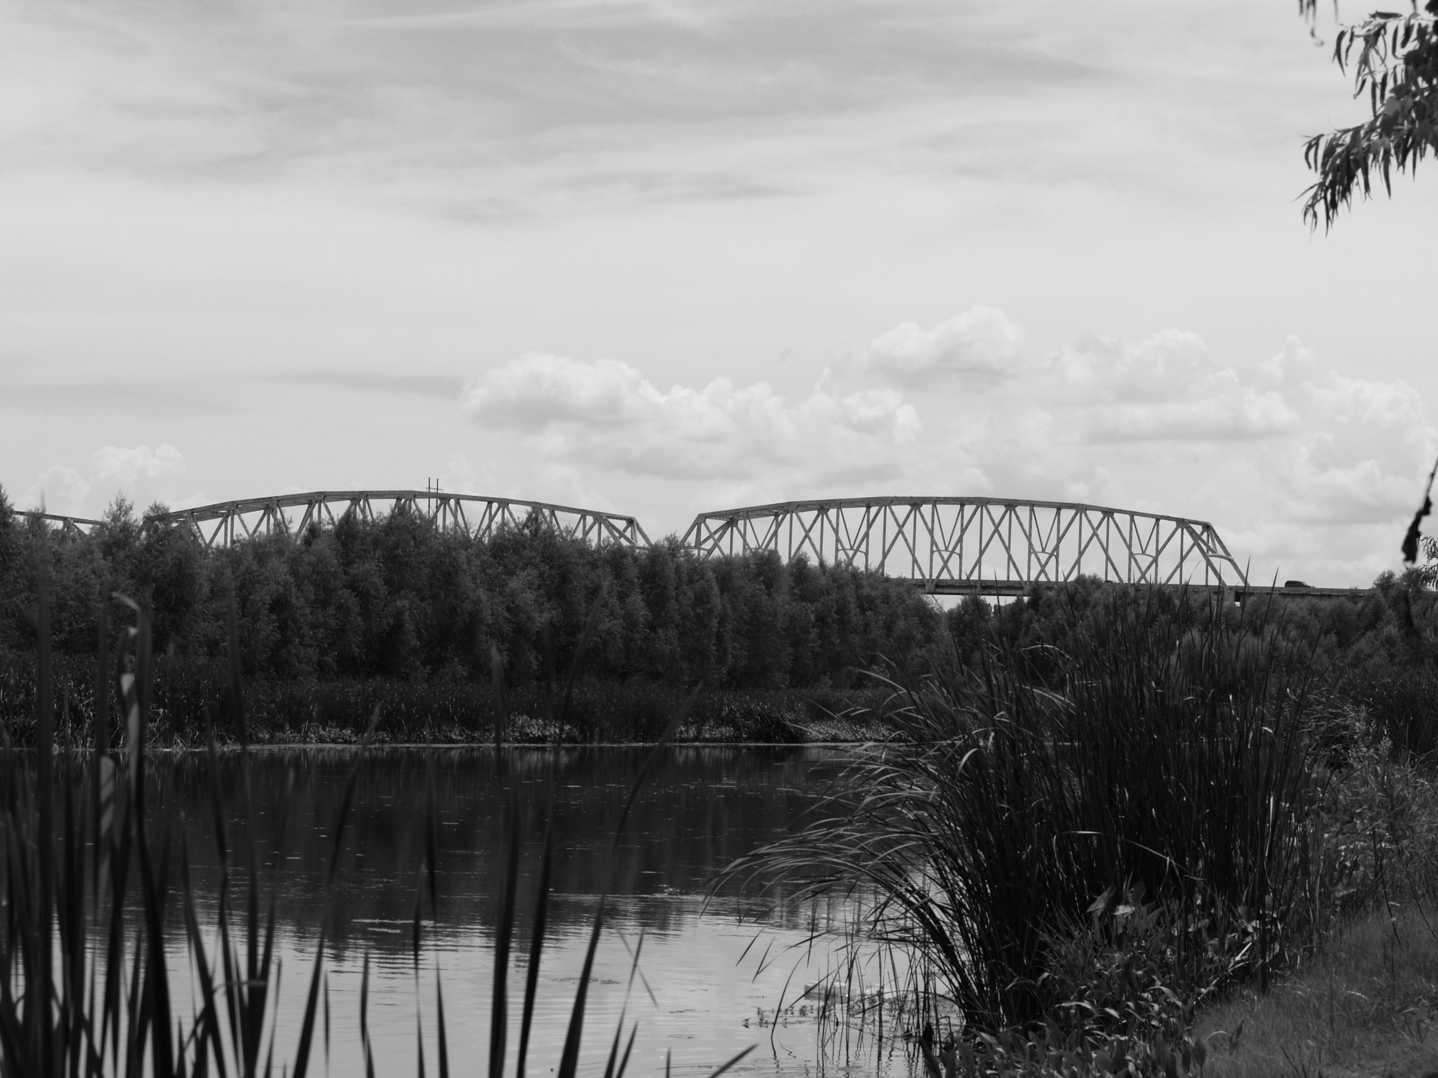

Draft Environmental Assessment
Red River Bridge at Jimmie Davis Highway
Route LA 511
Bossier and Caddo Parishes
State Project No. H.001779
Federal Aid Project No. STP-0800(507)
Public Hearing
May 14, 2015
Notes:
Welcome to the Public Hearing on the Draft Environmental Assessment of the Red River Bridge on Jimmie Davis Highway, LA 511 in Bossier and Caddo Parishes.
This recorded presentation provides an overview of the Draft Environmental Assessment.
The purpose of this Hearing and the public comment period is to inform the public of the alternatives that have been developed and analyzed, and to receive public comments before a preferred alternative is selected .
The presentation lasts approximately 30 minutes.

Slide 2
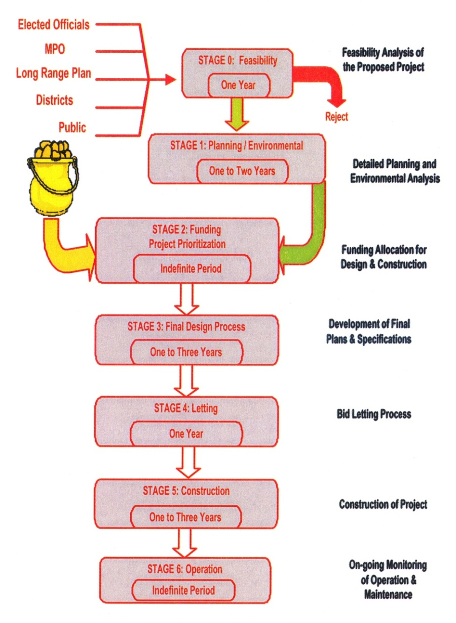

DOTD Project Delivery Process
Feasibility Analysis of
the Proposed Project
Detailed Planning and
Environmental Analysis
Funding Allocation for
Design & Construction
Development of Final
Plans & Specifications
Bid Letting Process
Construction of Project
On-going Monitoring
of Operations &
Maintenance
Notes:
This is an outline of the DOTD Project Delivery Process to carry a project forward from initial feasibility through environmental clearance, design, construction and operation. Please take a moment to review the process (pause).
Stage 0 was completed in 2009. We are now nearing the completion of Stage 1, which prepares the environmental analysis and selects a preferred alternative to be carried forward to final design and construction when funding is available. The concepts in this presentation include alternatives for a shared use trail and for improvements to Jimmie Davis Highway in association with the bridge. Only one bridge Build Alternative remains because the Rehabilitation Project for the existing bridge has resulted in the removal of the 4-lane bridge alternative from consideration. The alternatives studied were developed based on: the Stage 0 alternatives presented at the Public Information Meeting on August 15, 2013; your comments at that meeting; engineering considerations and environmental analyses; and comments from the environmental regulatory agencies, DOTD staff, and the FHWA. Your comments regarding these alternatives will help DOTD make a selection of the preferred alternative.

Slide 3
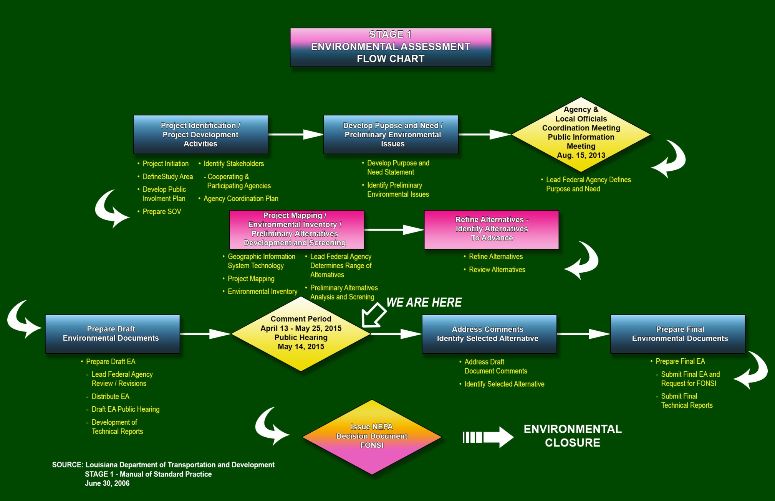
Stage 1 Flowchart
Notes:
This slide shows a more detailed description of Stage 1. We are currently at the Public Hearing that is held during the Comment Period.

Slide 4
Environmental Assessment Scope
Establish a Project Purpose and Need
Forecast Traffic and Level of Service (LOS) for the estimated Initial Year (2016) and the Design Year (2036)
Identify Design Concepts that Support the Purpose and Need
Conduct an Environmental Assessment in accordance with the National Environmental Policy Act (NEPA) to assure that there are no significant impacts
Estimate Conceptual Costs for Construction, Right-of-Way, and Professional Fees
Notes:
The Environmental Assessment tasks are intended to
Establish a Project Purpose and Need;
Forecast Traffic and Level of Service (LOS) for the implementation year (2016) and the Design Year (2036);
Investigate Design Concepts that support the Purpose and Need;
Conduct an Environmental Assessment in accordance with the National Environmental Policy Act (NEPA) to assure that there are no significant impacts; and
Estimate Probable Costs for Construction, Right-of-way, and professional fees.
These tasks have been completed and the findings are found in the Draft Environmental Assessment.
The remaining tasks include receiving your comments, and DOTD and FHWA selecting a Preferred Alternative.

Slide 5
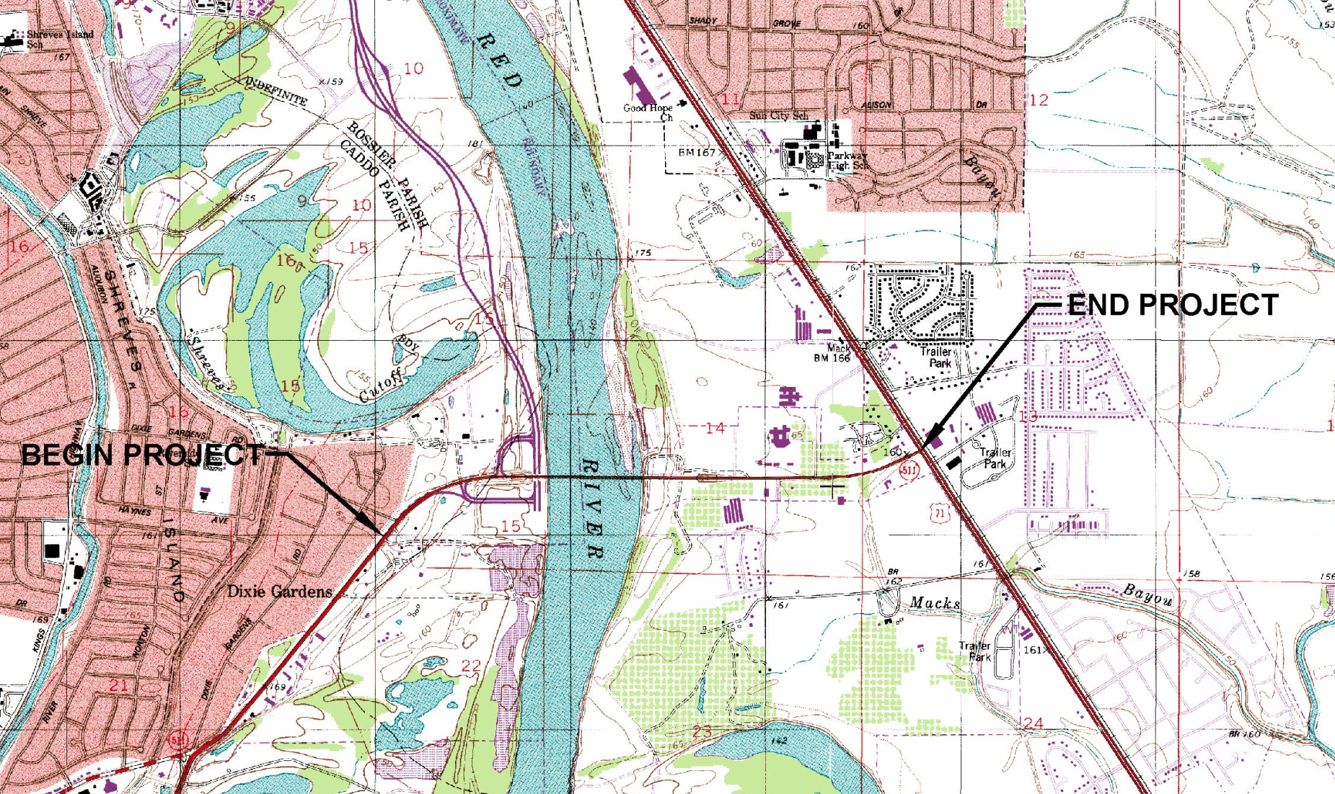
Project Area
Notes:
The Project Area extends along LA 511 from its intersection with East Dixie Meadow Road in Caddo Parish, across the Red River, to its intersection with Barksdale Boulevard, US 71, in Bossier Parish.

Slide 6
Purpose and Need
Project Purpose
The purpose of the proposed action is
to increase the vehicle capacity of the crossing of the Red River at Jimmie Davis Highway (LA 511);
to provide a safe river crossing for bicycles and pedestrians; and
to replace, or extend the life of, an aging bridge structure.
Notes:
A draft purpose and need statement was prepared during the Stage 0 Study. It was refined and presented for comment at the Public Information Meeting. This slide presents the Purpose that was established following that meeting, and approved by the Federal Highway Administration.
The following slides present the Needs for the project.

Slide 7
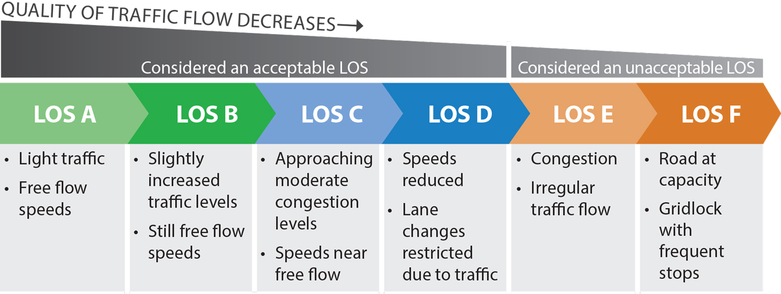
Need for Relief of Traffic Congestion
The existing bridge is a capacity constraint on the LA 511 corridor because it is a two lane link in a 5-lane roadway extending 5.35 miles from LA 523 to Barksdale Boulevard. In addition, Average Daily Traffic (ADT) is expected to increase from 27,955 in 2013 to 36,780 in 2036.
On the next slide, the Level of Service (LOS), a qualitative measure of traffic is discussed. This table explains what each letter indicates.
Notes:
The existing bridge is a capacity constraint on the LA 511 corridor because it is a two lane link in what is otherwise a 5-lane roadway extending 5.35 miles from LA 523 to Barksdale Boulevard.
Also, Average Daily Traffic (ADT) is expected to increase from
27,955 in 2013 to 36,780 in 2036.
These conditions affect the LOS of trips across the river.
The table shows how traffic is qualitatively described using letters with LOS A being free flow and LOS F being gridlock.

Slide 8

Need for Relief of Traffic Congestion
In 2013, the Level of Service in both directions was
LOS F during the AM peak and
LOS E during the PM peak.
In 2036, it is projected to be
LOS F in both directions during both peak periods.
To provide LOS C, two lanes in each direction are needed.
In 2013, the LOS at the signalized intersection of Jimmie Davis Highway and CenturyLink Center Drive / Zach Avenue at the bottom of the east bridge approach was
LOS C
In 2036, it is projected to be
LOS D
Notes:
In 2013, the LOS in both directions was LOS F during the AM peak and LOS E during the PM peak. In 2036, it is expected to be LOS F in both directions during both peak periods. To provide LOS C, two lanes in each direction are needed.
In 2013, the signalized intersection of Jimmie Davis Highway and CenturyLink Center Drive / Zach Avenue at the bottom of the east bridge approach had LOS C. In 2036, it is projected to have LOS D.

Slide 9
Need for Bicycle and Pedestrian Crossing
Regional and local plans support a connection between the Red River Bicycle Trail in Shreveport and the Arthur Ray Teague Jogging Trail in Bossier City.
The Northwest Louisiana Long Range Transportation Plan Update 2009-2030
  New 4-lane bridge structure with Bicycle Pedestrian facilities.
The Bossier City Comprehensive Plan (2002) states:
  Pedestrian crossing over the Red River
  Connect a bike trail over to Shreveport: Jimmie Davis Bridge
The Shreveport-Caddo 2030 Master Plan (2010) states:
  Support a “Complete Streets” policy that provides roadway space for bicycles, pedestrians, automobiles and transit vehicles.
  Integrate pedestrian networks and bikeways into the development of public spaces.
Notes:
Regional and local plans support a connection of the Clyde Fant Trail and the Arthur Ray Teague Trail to provide a river crossing for bicycles and pedestrians, including:
The Northwest Louisiana Long Range Transportation Plan Update 2009-2030 that describes this project as LA 511 (Jimmie Davis Highway) Red River crossing - New 4-lane bridge structure with Bicycle Pedestrian facilities.
The Bossier City Comprehensive Plan (2002) that calls for
A Pedestrian crossing over the Red River, and
To connect a bike trail over to Shreveport: Jimmie Davis Bridge
The Shreveport-Caddo 2030 Master Plan (2010) that calls for
A “Complete Streets” policy that provides roadway space for bicycles, pedestrians, automobiles and transit vehicles, and integrates greenway and off-road bicycle routes with the roadway system, and
Integrated pedestrian networks and bikeways in the development of public spaces and linking community destinations through on- and off-street facilities.

Slide 10
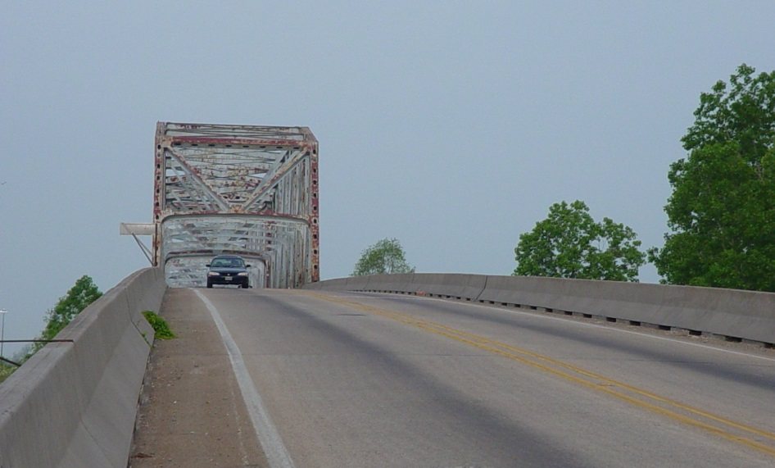
Need for Improved Safety
Structural
The existing bridge is 45 years old and is showing signs of aging, including corrosion of steel members, erosion of the embankment, and cracks and spalling to the abutment walls and the deck.
Operating
The existing 2-lane bridge does not have shoulders, sidewalks, or bicycle lanes.
Notes:
Two safety aspects apply to this project: structural and operating.
Structural safety is needed because:
The existing bridge is 45 years old and is showing signs of aging, including corrosion of steel members, erosion of the embankment, and cracks and spalling to the abutment walls and the deck.
Operating safety is needed because:
The existing 2-lane bridge does not have shoulders, sidewalks, or bicycle lanes.

Slide 11
Need for Access Improvements to
Traffic Generators and Transportation Improvements
The location of the CenturyLink Center near the east approach of the bridge, future transportation projects, and the following recently completed transportation projects are anticipated to increase traffic demand at the eastern approach.
  The 5-lane section along LA 511 from the bridge to Barksdale Boulevard,
  The extension of the Arthur Ray Teague Parkway to the intersection of Barksdale Boulevard and Sligo Road, and
  The exit ramps from both eastbound and westbound Jimmie Davis Highway to the Arthur Ray Teague Parkway.
Notes:
The location of the CenturyLink Center near the east approach of the bridge, future transportation projects, and the following recently completed transportation projects are anticipated to increase traffic demand at the eastern approach, and have added to the need for this project since Stage 0 was completed:
Construction of the 5-lane section along LA 511 from the bridge to Barksdale Boulevard,
The extension of the Arthur Ray Teague Parkway to the intersection of Barksdale Boulevard and Sligo Road, and
The exit ramps from both eastbound and westbound Jimmie Davis Highway to the Arthur Ray Teague Parkway.

Slide 12
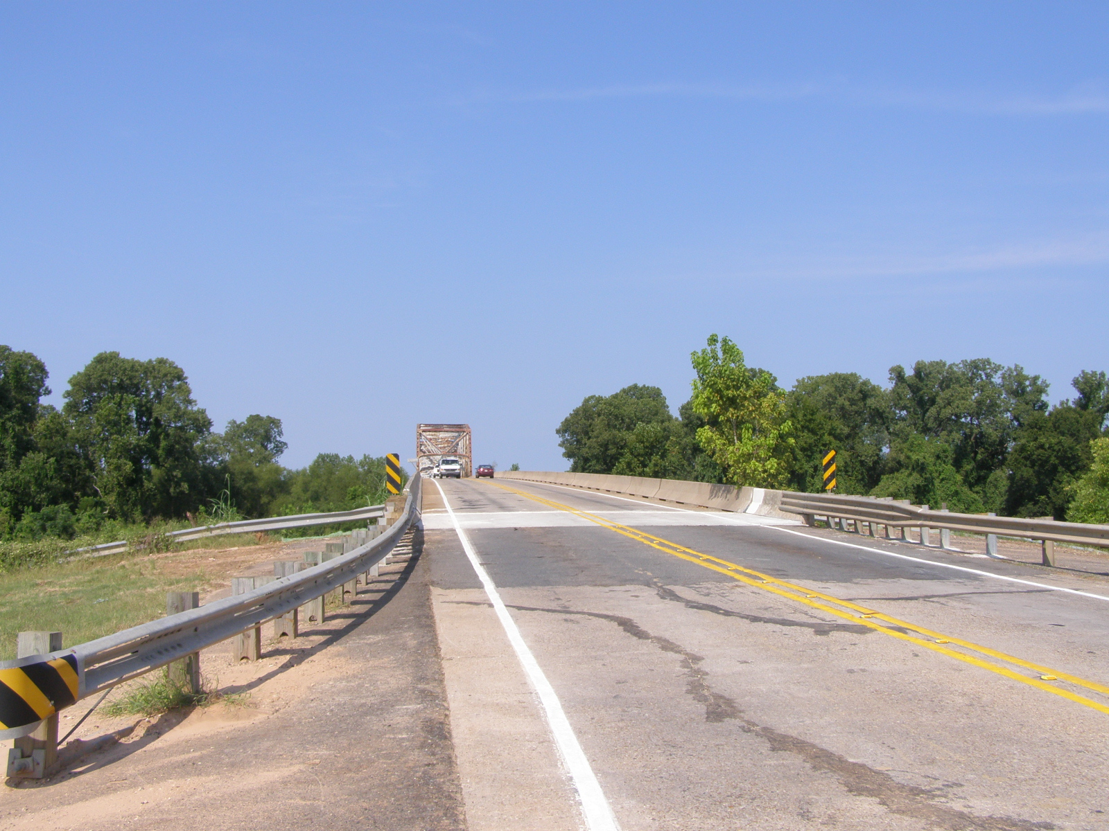
Alternatives
Notes:
The following slides discuss the proposed alignments of the alternatives.
Large-scale drawings are available here tonight for your review, and the planners and engineers are available to answer your questions.

Slide 13
The Alternatives studied in the EA include the
No-Build Alternative and several Build Alternatives
The No-Build Alternative
serves as a benchmark to allow for the meaningful comparison of the magnitude of environmental effects associated with the Build Alternatives and
assumes construction of all programmed projects, including the Jimmie Davis Bridge Rehabilitation, except for this project.
    Programmed projects are those listed in the Northwest Louisiana Council of Governments (NLCOG) Short Range Program (Federal Fiscal Years 2013-2015) – Transportation Improvement Projects (TIP).
Notes:
The Alternatives studied in the EA include the No-Build Alternative and several Build Alternatives
The No-Build Alternative
serves as a benchmark to allow for the meaningful comparison of the magnitude of environmental effects associated with the Build Alternatives; and
assumes construction of all programmed projects in the project area, including the Jimmie Davis Bridge Rehabilitation, except for this project.
The programmed projects are those listed in the Northwest Louisiana Council of Governments (NLCOG) Short Range Program (Federal Fiscal Years 2013-2015) – Transportation Improvement Projects (TIP).

Slide 14
No-Build Alternative
Under the No-Build Alternative the existing Jimmie Davis Bridge will be rehabilitated to extend its useful life for 30 years, and it will continue to operate as a two-lane facility. The other short-term programmed projects will upgrade the project area network, but will not add capacity to LA 511.
Name | Route | Limits | Improvements | Plan Phase (Year) | Cost Estimate ($000’s) | Primary Funding
Sunflower Blvd Extension | Local | Existing Sunflower Blvd. to new A.R. Teague Parkway Extension | New two-lane urban collector | SRP (2014) | 750 | Local Funding Bossier City
Golden Meadows Dr Extension | Local | US 71 to new A.R. Teague Parkway Extension | New four-lane local boulevard section | SRP (2015) | 3,500 | Local Funding Bossier City
LA 511: Jimmie Davis Bridge Rehabilitation | State | LA 511 Red River Crossing | Rehabilitation of existing two-lane bridge | 2014 | 20,000 | State Bonds
Notes:
Under the No-Build Alternative, the existing Jimmie Davis Bridge will be rehabilitated to extend its useful life for 30 years, and it will continue to operate as a two-lane facility.
The other two projects will upgrade the project area network, but will not add capacity to LA 511.

Slide 15
Build Alternatives
The EA evaluated the following:
Two Bridge Alternatives: 5 and 7.
Two Trail Alternatives: 1 and 2.
Four Access Alternatives: A without C, A with C, B without C, and B with C.
This resulted in 16 possible combinations of Build Alternatives.
As discussed on the next slide, 8 Build Alternatives remain for consideration at this Hearing.
Notes:
The EA evaluated the following Build Alternatives:
Two Bridge Alternatives: 5 and 7.
Two Trail Alternatives: 1 and 2.
Four Access Alternatives: A without C, A with C, B without C, and B with C.
Initially, this resulted in 16 possible combinations of Build Alternatives.
As a result of adding the Rehabilitation Project to the No Build and as discussed on the next slide, 8 Build Alternatives remain for your consideration and comment at this Hearing.

Slide 16
The Build Alternatives were based on the Stage 0 Alternatives and the agency and public comments on received by DOTD in 2013.
In 2014, DOTD began the Jimmie Davis Bridge Rehabilitation Project to improve the existing bridge to extend its useful life.
The Rehabilitation Project results from a separate study that was underway when the EA was initiated.
Due to the substantial investment being made by the Rehabilitation Project, FHWA and DOTD determined that Bridge Alternative 5, a new four-lane bridge, is no longer under consideration under this NEPA action.
Bridge Alternative 5 was not removed from the EA document to demonstrate that a full range of alternatives was developed, but is not addressed in this presentation.
Notes:
The Build Alternatives evaluated in this EA, were based on agency and public comments on the Stage 0 Build Alternatives received by DOTD in August 2013.
Subsequently, in 2014, DOTD began the Jimmie Davis Bridge Rehabilitation Project to improve the existing bridge to extend its useful life for an estimated 30 years.
The rehabilitation project is the outcome of a separate study that was underway at the time that this EA was initiated.
Due to the substantial investment being made through the rehabilitation project, it has been determined by FHWA and DOTD that Bridge Alternative 5 is no longer under consideration as an element of the Preferred Alternative under this NEPA action.
Bridge Alternative 5 was not removed from the EA to demonstrate that a full range of alternatives was developed, and to avoid any unnecessary delay in the completion of this NEPA process.

Slide 17
Therefore…
As Bridge Alternative 5 is no longer being considered,
The Preferred Alternative either will be made up of:
    Bridge Alternative 7,
    one of the two Trail Alternatives, and
    one of the four Access Alternatives,
or it will be
    The No-Build Alternative.
The following slides and the display maps illustrate these alternatives.
Notes:
Therefore, as Bridge Alternative 5 is no longer being considered,
The Preferred Alternative, if a Build Alternative is selected, will be made up of:
Bridge Alternative 7,
one of the two Trail Alternatives, and
one of the four Access Alternatives.
The following slides and the display maps illustrate these alternatives.

Slide 18
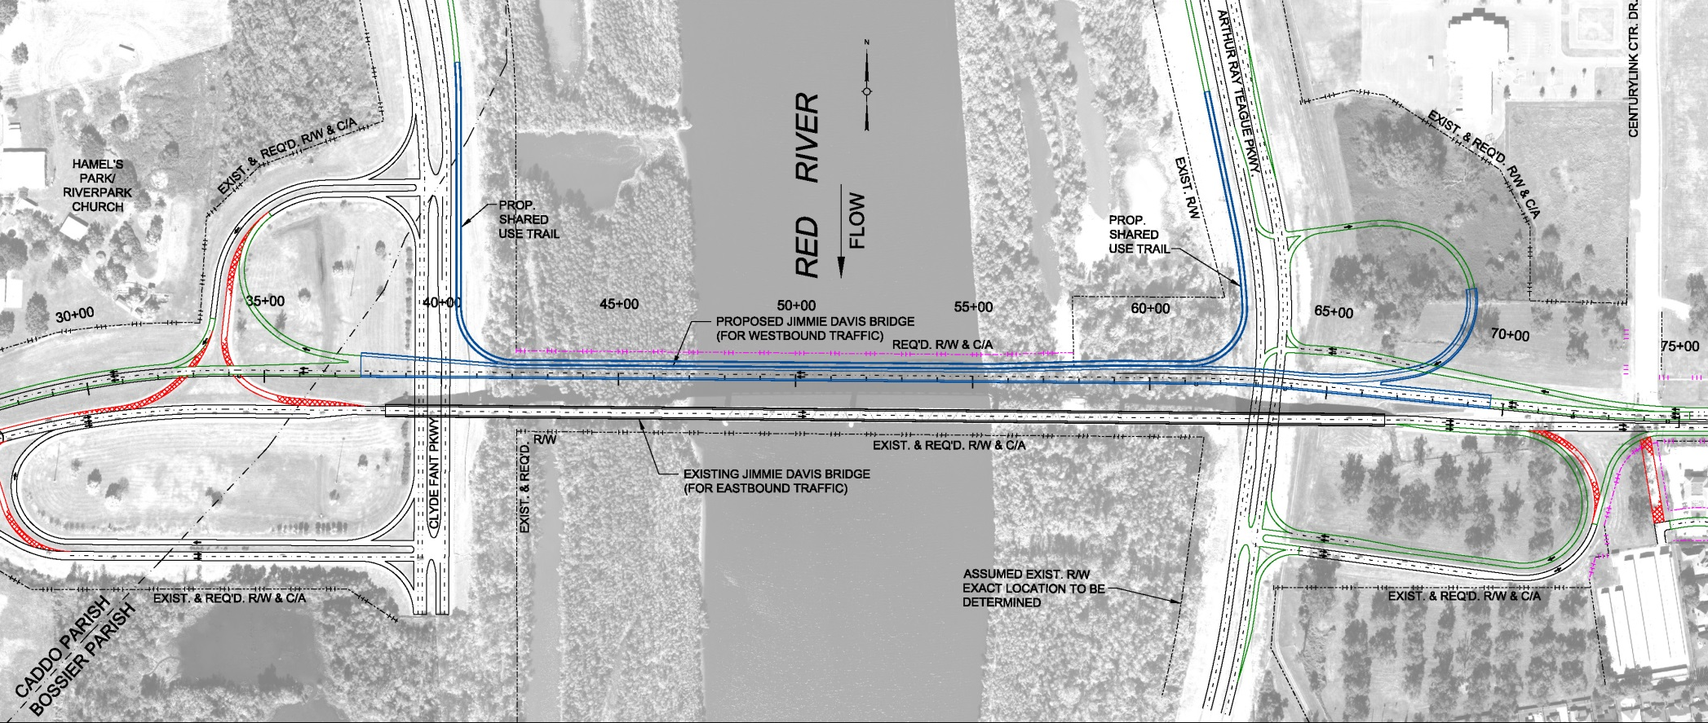
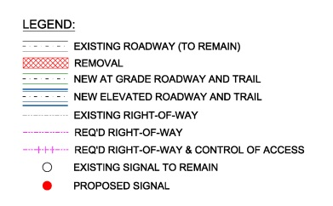
Bridge Alternative 7
Notes:
Bridge Build Alternative 7 calls for the construction of a new 2-lane westbound bridge north of the existing structure.
It would include:
Improvements to the LA 511 interchange with the Clyde Fant Parkway,
Development of a full LA 511 interchange with the Arthur Ray Teague Parkway in Bossier City, and
The elevated portions of either Trail Alternative.

Slide 19
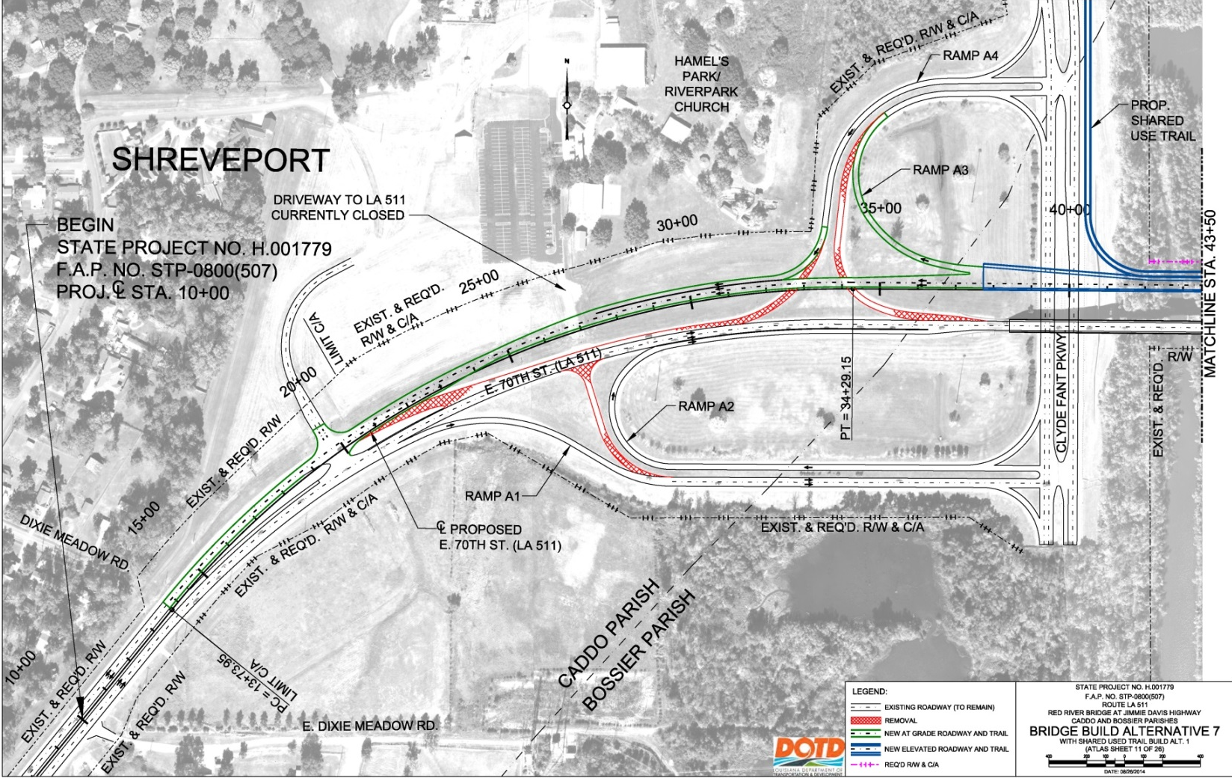
Bridge Alternative 7 – Caddo Parish
Notes:
The slide shows a detail view of Bridge Build Alternative 7 in Caddo Parish combined with Trail Alternative 1.

Slide 20
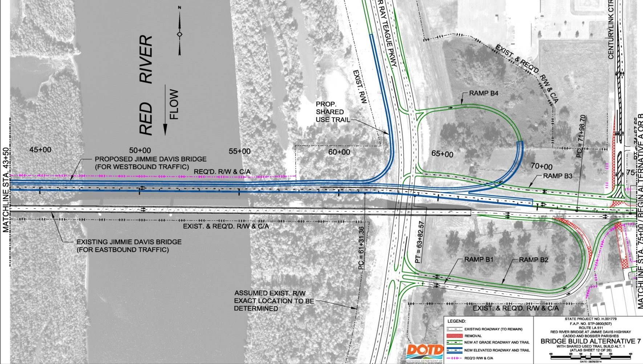
Bridge Alternative 7 – Bossier Parish
Notes:
The slide shows a detail view of Bridge Alternative 7 in Bossier Parish combined with Trail Alternative 1 and Access Alternative A.

Slide 21
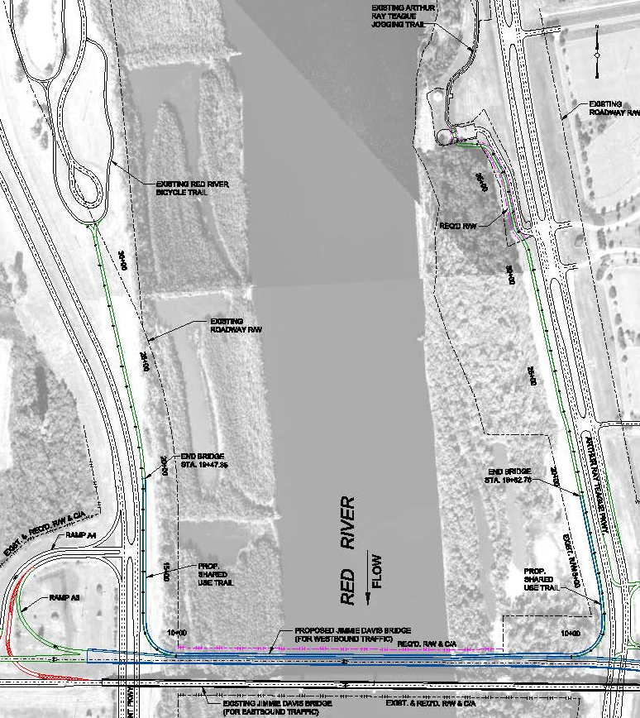
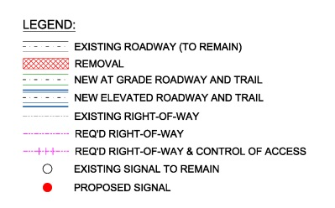
Trail Alternative 1
Notes:
21
Trail Alternative 1, shown here in combination with Bridge Alternative 7, directly connects the Red River Bicycle Trail in Shreveport with the Arthur Ray Teague Jogging Trail in Bossier City using extensions of these trails along the river to the point where they must be elevated to reach the bridge.

Slide 22
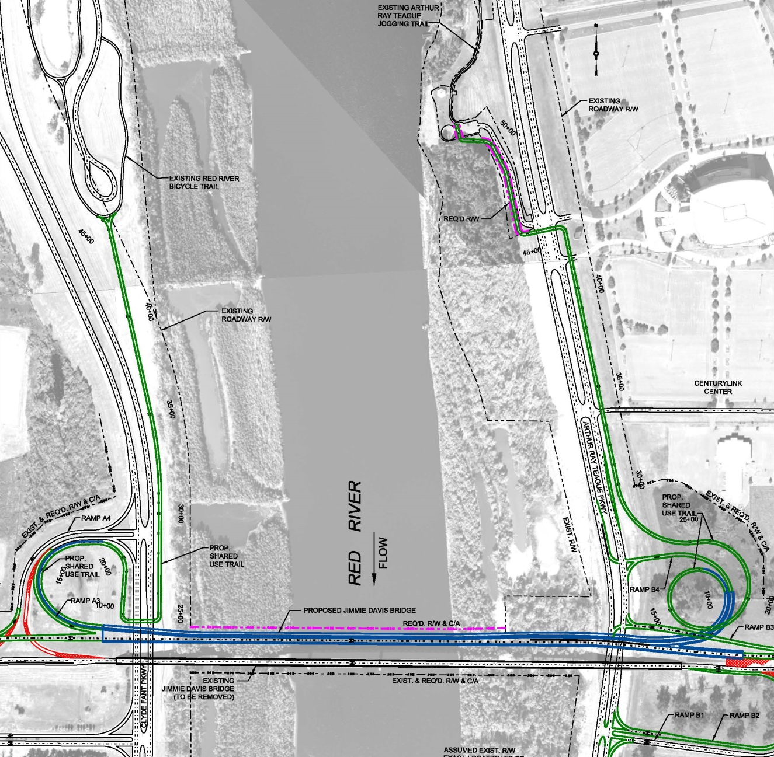
Trail Alternative 2
Notes:
22
Trail Alternative 2, shown here in combination with Bridge Alternative 7 also connects the Red River Bicycle Trail in Shreveport with the Arthur Ray Teague Jogging Trail in Bossier City by continuing the trail across the bridge until both reach grade. From these points, it then is extended at grade to join the existing trails on each side of the river.

Slide 23
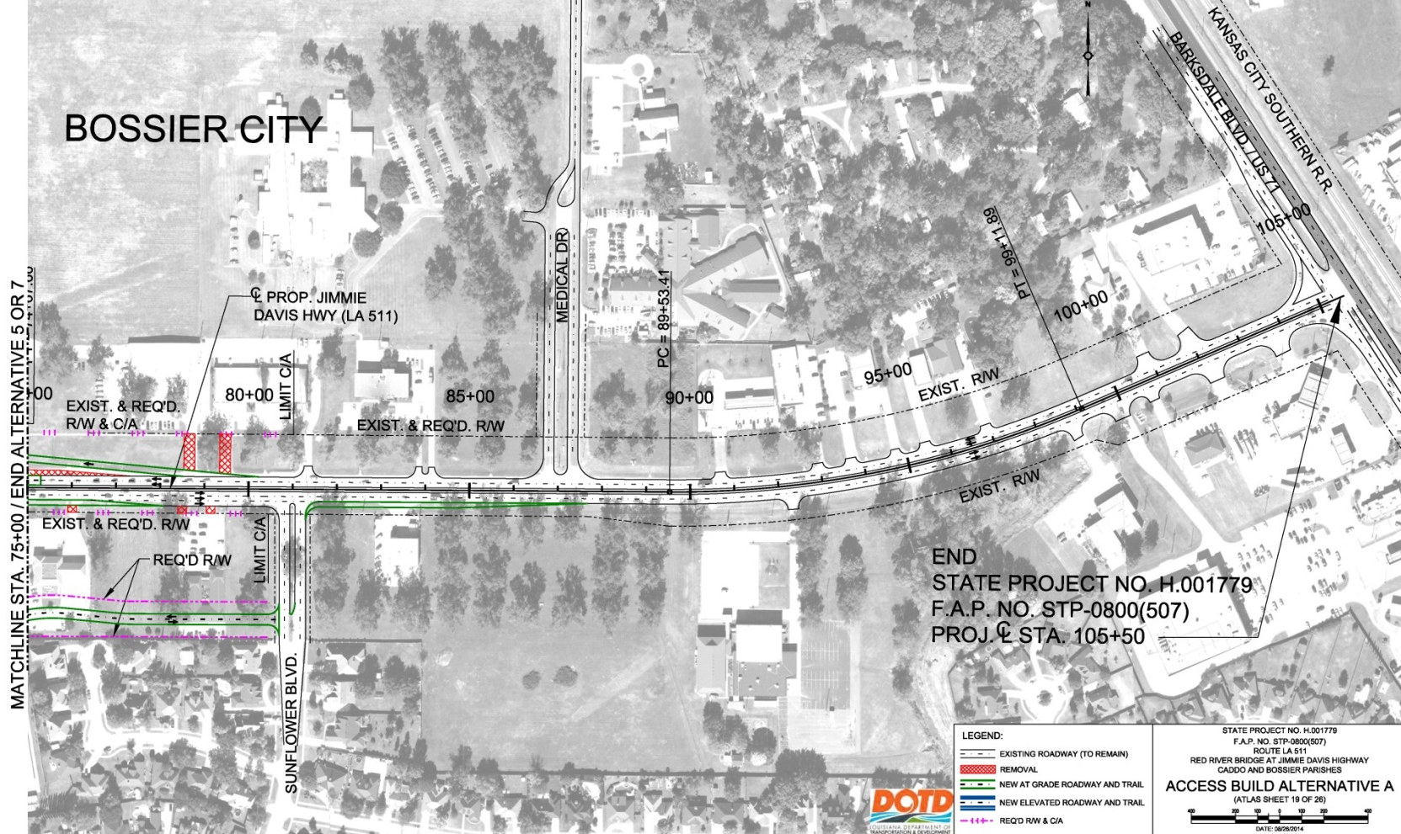
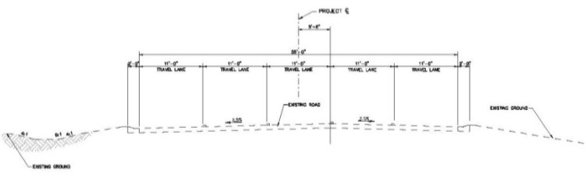
Access Alternative A without Alternative C
Notes:
23
Access Alternative A maintains the existing 5-lane roadway of Jimmie Davis Highway from the bridge to Barksdale Boulevard.
On the south side of LA 511, it includes a new service road connected to Sunflower Boulevard to provide access to BLM Storage and avoid its relocation, and to provide access to the other properties between Zach Avenue and Sunflower Boulevard that would have no access without the service road. The existing uses on these properties could be relocated as a result of the eastbound entrance ramp from Arthur Ray Teague Parkway.
On the north side of LA 511, it would remove access from three properties as a result of the control of access required for the westbound exit ramp from LA 511 to the Arthur Ray Teague Parkway.

Slide 24
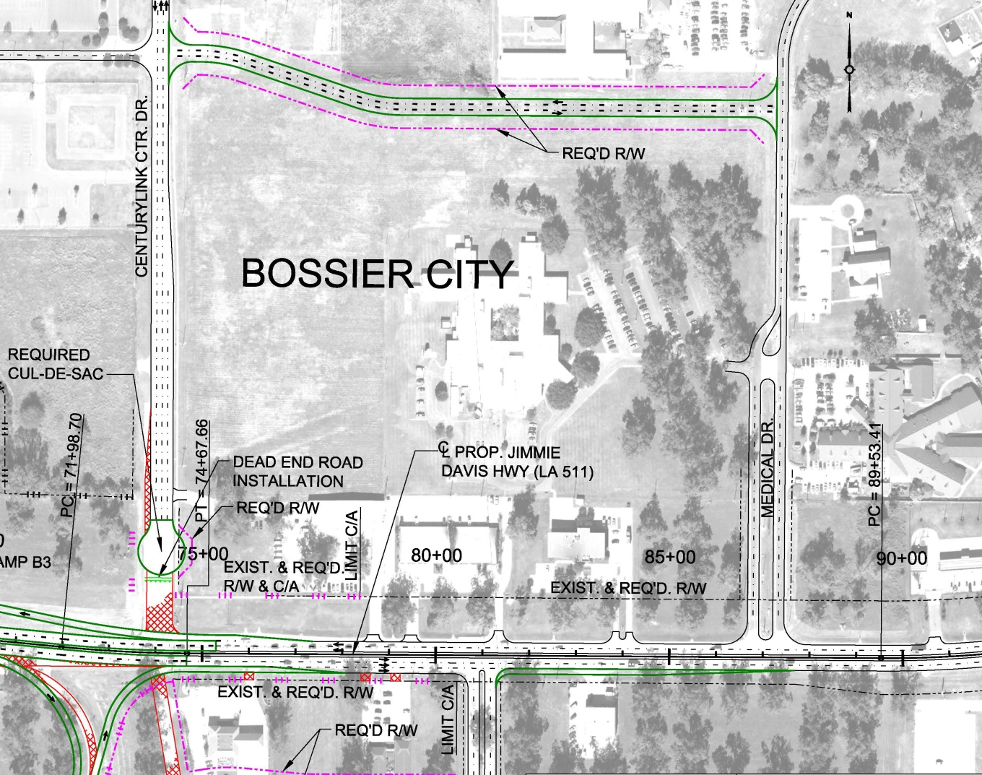
Access Alternative A with Alternative C
Notes:
24
As described on the previous slide, Access Alternative A maintains the existing 5-lane roadway of Jimmie Davis Highway from the bridge to Barksdale Boulevard, and the same changes are found on the south side.
Alternative C has a different impact on the north side of LA 511. No access would be removed, because the exit ramp from LA 511 to the Arthur Ray Teague Parkway would be moved farther west. This would require closing the intersection of CenturyLink Center Drive with LA 511 and providing a new roadway to the north connecting CenturyLink Center Drive to Medical Drive at its intersection with Reeves Marine Drive.

Slide 25
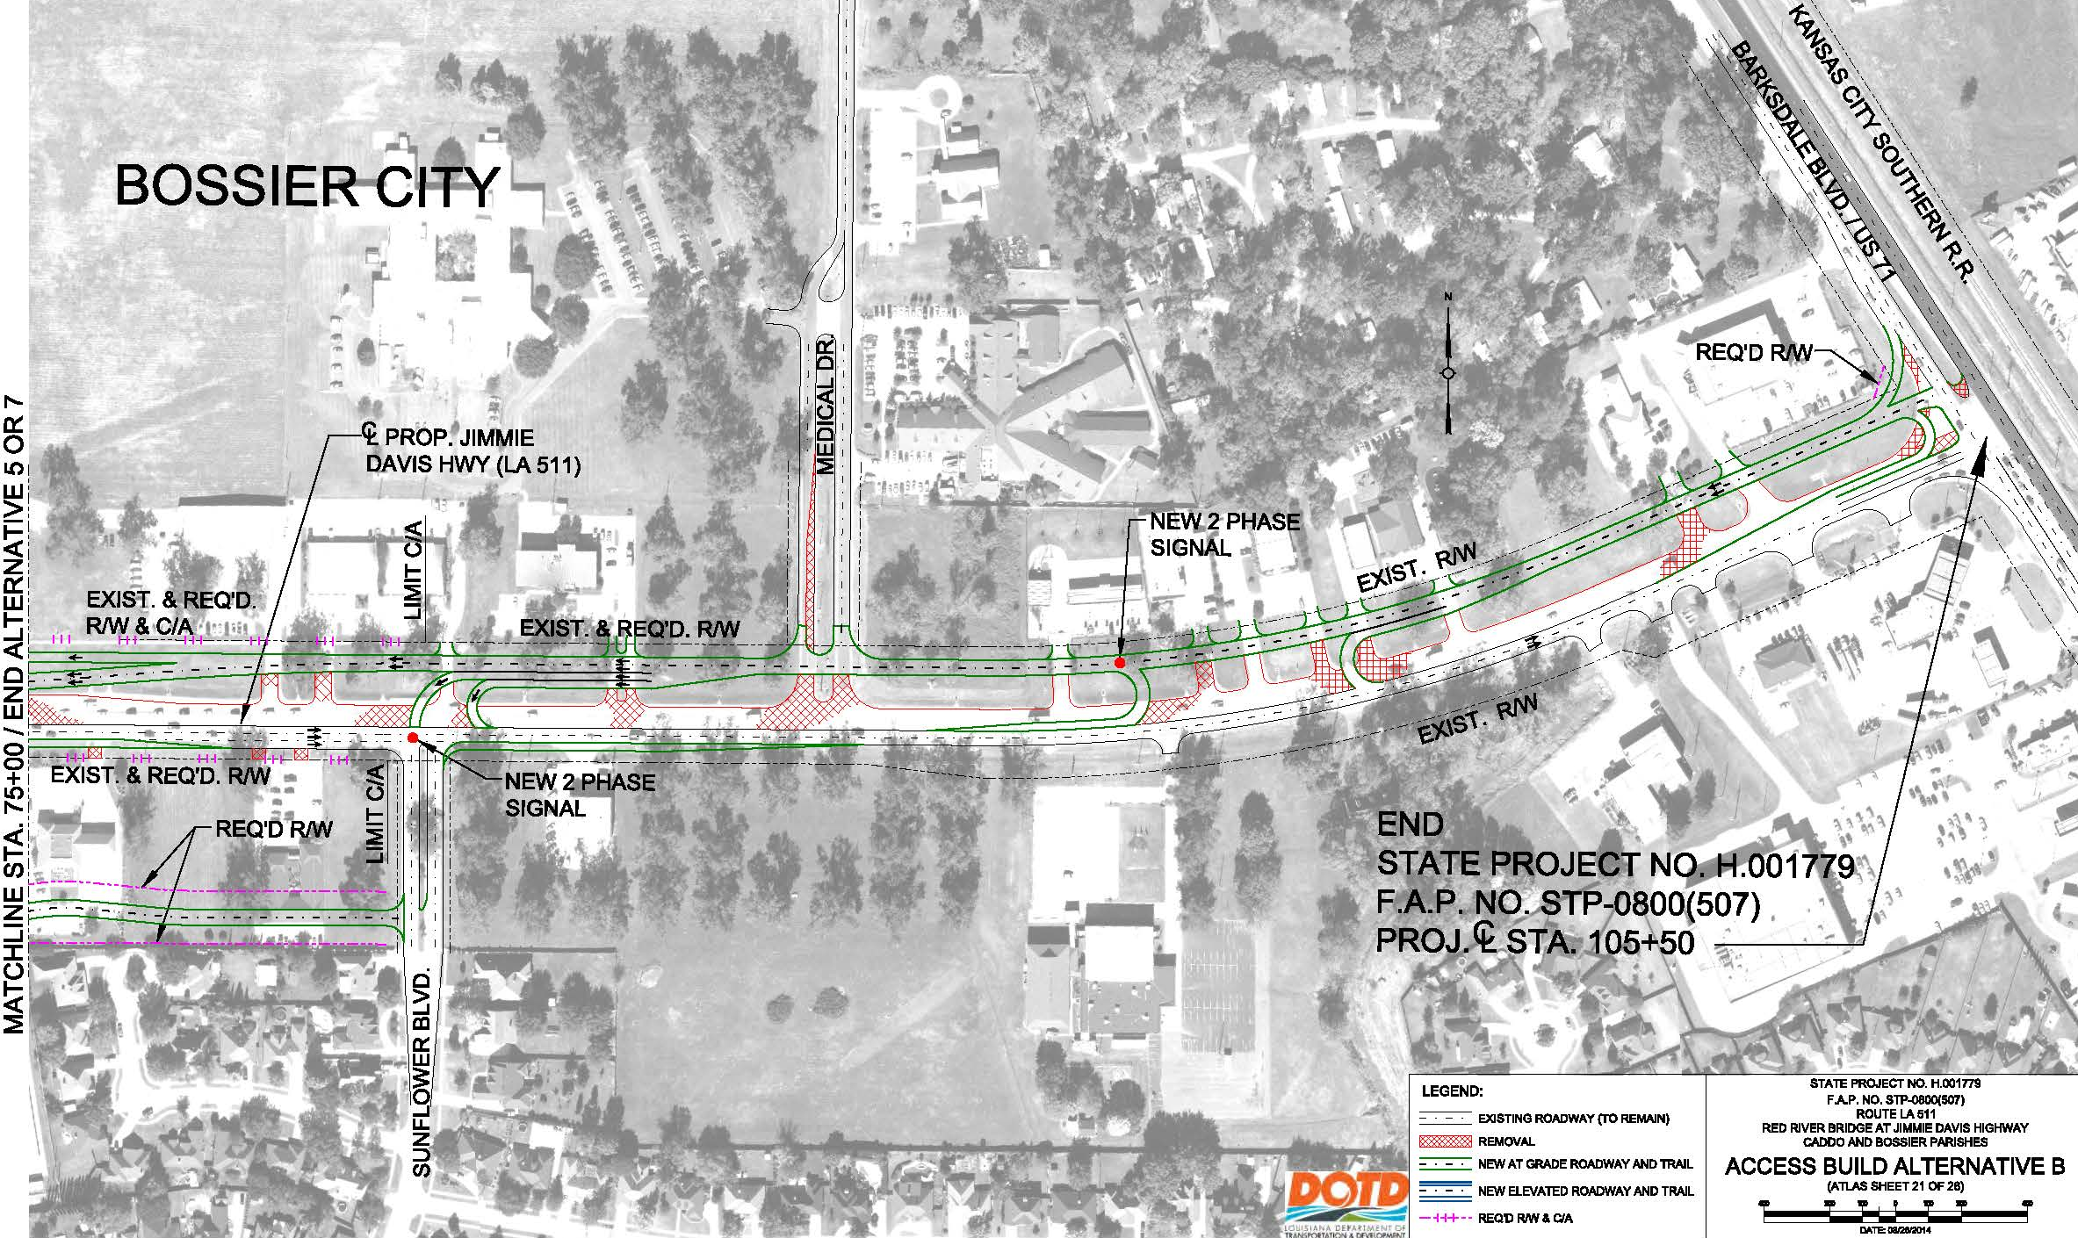
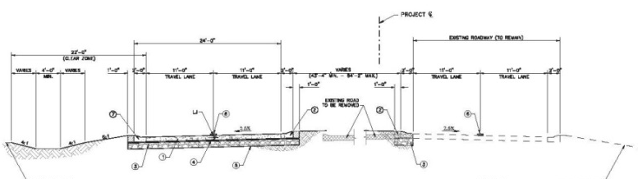
Access Alternative B without Alternative C
Notes:
25
Access Alternative B reconstructs the westbound roadway of Jimmie Davis Highway to create a boulevard section employing access management concepts with U-turns and J-turns from the bridge to Barksdale Boulevard.
It also includes the service road on the south side and also would have the same access impacts and potential relocation requirements as Alternative A.

Slide 26
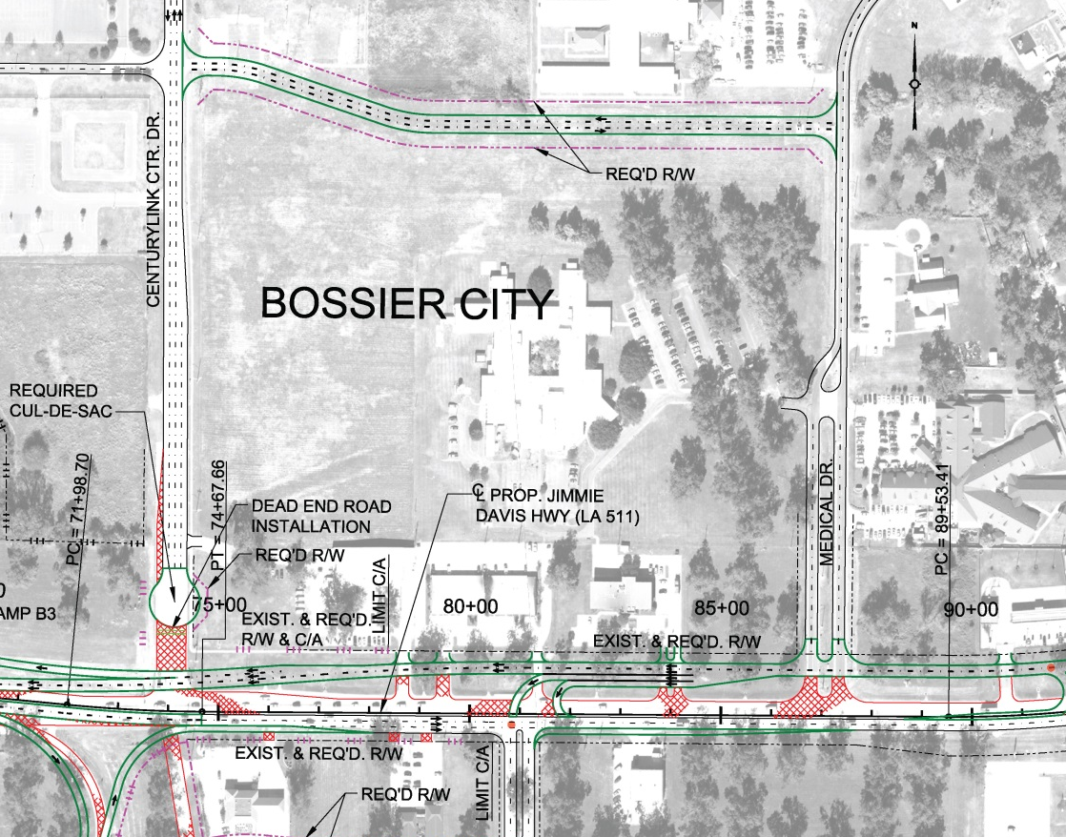
Access Alternative B with Alternative C
Notes:
26
As described on the previous slide, Access Alternative B develops a boulevard along Jimmie Davis Highway from the bridge to Barksdale Boulevard, and, on the south side of LA 511, it includes the same new service road connected to Sunflower Boulevard and has the same potential impacts as Alternative A.
Alternative C, as described in combination with Alternative A, has a different impact on the north side of LA 511. No access would be removed because the exit ramp from LA 511 to the Arthur Ray Teague Parkway would be moved farther west. This would require closing the intersection of CenturyLink Center Drive with LA 511 and providing a new roadway to the north connecting CenturyLink Center Drive to Medical Drive at its intersection with Reeves Marine Drive.

Slide 27
Estimated Implementation Cost
Implementation costs for the project were estimated for two Bridge Construction Options: Concrete and Steel.
This results in 16 different project cost estimates (2 each for each of the 8 combinations of alternatives). The cost of each combination of Bridge, Trail, and Access Alternatives, in millions of 2014 dollars, including right-of-way, relocation, environmental mitigation, and construction are shown on an exhibit. The combinations with the lowest and highest costs are shown below:
Combinations of Alternatives | Steel Construction | Concrete Construction
Bridge 7, Trail 2 & Access A without C has the lowest cost. | $ 74.0 | $ 72.3
Bridge 7, Trail 1 & Access B with C has the highest cost. | $81.4 | $80.9
Notes:
Project implementation costs were estimated for both steel and concrete construction options for the bridge resulting in 16 different costs are shown on the exhibits. This slide shows the most costly ( Bridge Alternative 7 in steel, Trail 1, Access B with C) and the least costly (Bridge 7 in concrete, Trail 2, Access A without C) combinations of alternatives and construction method.

Slide 28
Environmental Assessment
The Environmental Assessment included detailed investigations of potential impacts to the environment.
No impacts were identified for the following conditions and resources:
Land Use | Scenic Streams
Environmental Justice | Coastal Zone
Parks and Recreation | Contaminated Materials Sites
Vegetation | Air Quality during Operation
Significant Trees | Traffic Noise during Operation
Wildlife | Water Quality during Operation
Notes:
The Environmental Assessment included detailed investigations of potential impacts to the environment.
No impacts were identified for :
Land Use
Environmental Justice
Parks and Recreation
Vegetation
Significant Trees
Wildlife
Scenic Streams
Coastal Zone
Contaminated Material Sites
Air Quality during Operation
Traffic Noise during Operation, and
Water Quality during Operation

Slide 29
Environmental Assessment
The next 11 slides present the conditions and resources that potentially would be affected and the means that will be used to avoid, minimize or mitigate those effects.
No significant adverse impacts were found.
Notes:
The next 11 slides present the conditions and resources that would, or potentially would, be affected and the means to avoid, minimize, or mitigate them.
Importantly, no significant adverse impacts were found.

Slide 30
Right-of-Way Acquisition
Most of the project footprint would be within existing DOTD highway right-of-way or transportation rights-of-way of local governments. Therefore, the acquisition of large amounts of right-of-way from private or public property owners would not be required.
The acres and estimated costs of right-of-way by alternative are shown below:
Alternative | Acres | Acquisition Cost
Bridge 7 | 0.018 | $ 16,500
At-grade Trail 1 | 0.396 | $ 10,000
At-grade Trail 2 | 0.399 | $ 10,000
Access A | 1.124 | $ 4,670,000
Access B | 1.142 | $ 4,707,000
Access C | 2.570 | $ 1,565,200
Notes:
Most of the project footprint would be within existing DOTD highway right-of-way or transportation rights-of-way of local governments.
The acreage and estimated cost of right-of-way acquisition are shown in the table. The only substantial costs result from the construction of the Access Alternatives.

Slide 31
Access Impacts
Access impacts potentially would affect these commercial properties. Those in white cells would be impacted by all alternative combinations. The others could be impacted depending on which alternative combination is selected.
Property | Address | Alternatives
Regions Bank | 1600 Jimmie Davis Hwy | 7 and A or B
Vacant Lot | 1604 Jimmie Davis Hwy
Professional Plaza: Baker Title & Abstract Gateway Title Co., LLC Assurance Financial Group, LLC Centerline Plan Services Chris Gardner, DDS Morris White, DDS | 1608 Jimmie Davis Hwy
BLM Storage | 5004 Zach Ave | A or B if service road is not constructed
Henson’s Carpet One Floor | 1609 Jimmie Davis Hwy | A or B without C
Functional Capacity Experts | 1611 Jimmie Davis Hwy
Dental Office | 1611 Jimmie Davis Hwy
Notes:
Access impacts leading to relocation potentially would affect these commercial properties.
Those in white cells would be impacted by all alternative combinations.
The others could be impacted depending on which alternative combination is selected.
Again, the Access Alternatives generate the majority of the effects.

Slide 32
Community Facilities
CenturyLink Center
Both Access Alternatives A and B would eliminate eastbound to northbound and southbound to eastbound turns at LA 511 and CenturyLink Center Drive. Access and egress to and from CenturyLink Center using these movements would be mitigated by completing the LA 511 / Arthur Ray Teague Parkway interchange, and, if constructed, Alternative C from Medical Drive.
Cornerstone Hospital and Barksdale Baptist Church
Access Alternative B results in changes in access, but no minimization is required.
Notes:
These community facilities potentially would be affected by the alternatives and the effects would be minimized as shown below:
CenturyLink Center
Access Alternatives A and B would eliminate eastbound to northbound and southbound to eastbound turns at LA 511 and CenturyLink Center Drive. Access and egress to and from CenturyLink Center using these movements would be mitigated by completing the LA 511 / Arthur Ray Teague Parkway interchange, and, if constructed, Alternative C from Medical Drive.
Cornerstone Hospital and Barksdale Baptist Church
Access Alternative B results in changes in access, but no minimization is required.

Slide 33
Cultural Resources
The existing Jimmie Davis Bridge is the only historic property within the Study Area.
Bridge Alternative 7 would benefit from the rehabilitation of the existing bridge under the No-Build Alternative.
Section 106 and Section 4(f) procedures relative to the existing bridge will be resolved through the implementation of the Rehabilitation project.
No archaeological resources would be affected by the project.
Notes:
The existing Jimmie Davis Bridge is the only historic property within the Study Area.
Bridge Alternative 7 would benefit from the rehabilitation of the existing bridge under the No-Build Alternative. Section 106 and Section 4(f) procedures relative to the existing bridge will be resolved through the implementation of the Rehabilitation project.
No archaeological resources would be affected by the project.

Slide 34
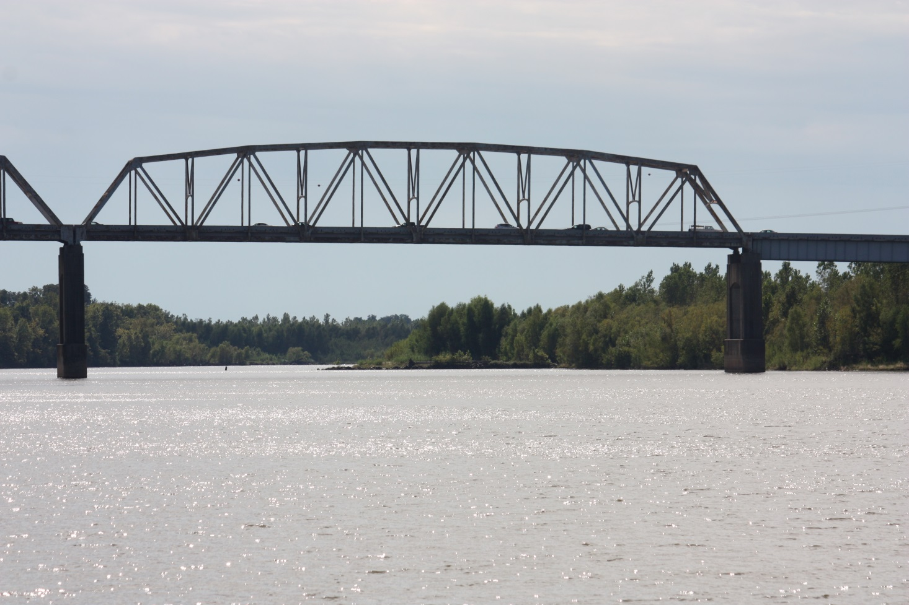
Aesthetics
To avoid any potential adverse impacts to aesthetics, context sensitive design elements will be examined during final design.
Notes:
To avoid any potential adverse impacts to aesthetics, context-sensitive design elements will be examined during final design.

Slide 35
Wetlands and Waters of the United States
Impacts to wetlands and waters of the US would result from the construction of the Bridge and Trail Alternatives.
The Access Alternatives would not impact these resources.
Mitigation requirements will be determined in conjunction with the Section 404 and Section 10 permit process.
Alternatives | Wetlands | Waters of the U.S.
Bridge 7 and Trail 1 | 1.66 acres | 1.04 acres
Bridge 7 and Trail 2 | 1.66 acres | 1.04 acres
Notes:
Impacts to wetlands and waters of the US would result from the construction of the Bridge and the Trail Alternatives.
The Access Alternatives would not impact these resources.
As shown in the table, the acreage impacted by each combination of alternatives for each resource is not great.
Mitigation requirements will be determined in conjunction with the Section 404 and Section 10 permit process.

Slide 36
100-year Floodplains
Impacts to 100-year Floodplains would result from the construction of the Bridge and Trail Alternatives.
The Access Alternatives would not impact this resource.
Mitigation requirements will be determined in conjunction with the local floodplain permit process.
Alternatives | 100-year Floodplain
Bridge 7 and Trail 1 | 6.43 acres
Bridge 7 and Trail 2 | 7.20 acres
Notes:
Impacts to 100-year floodplains would result from the construction of the Bridge and Trail Alternatives.
The Access Alternatives would not impact this resource.
As shown in the table, the impacted acreage by each combination of alternatives is not great.
Mitigation requirements will be determined in conjunction with the local floodplain permit process.

Slide 37
Groundwater Resources
Access Alternative B potentially would affect groundwater resources.
Additional investigation will be undertaken during final design and avoidance, minimization or mitigation will be determined at that time.
Soils
All alternatives potentially would affect soils during construction and afterwards if Best Management Practices (BMP) are not followed.
Adverse impacts will be avoided through BMP.
Notes:
Access Alternative B potentially would affect groundwater resources.
If it is selected, additional investigation will be undertaken during final design and any required avoidance, minimization or mitigation will be determined at that time.
All alternatives potentially would affect soils during and after construction if Best Management Practices (BMP) are not followed.
Adverse impacts will be avoided through BMP.

Slide 38
Threatened and Endangered Species
The Interior Least Tern and the Pallid Sturgeon potentially occur within the project area.
To minimize or mitigate the potential impacts, consultation will be undertaken with the Louisiana Natural Heritage Program (LNHP) if construction activities are scheduled during breeding seasons :
Late April through August for the Interior Least Tern, and
May through August for the Pallid Sturgeon.
Notes:
The Interior Least Tern and the Pallid Sturgeon potentially occur within the project area.
To minimize or mitigate the potential impacts, consultation will be undertaken with the Louisiana Natural Heritage Program (LNHP) if construction activities are scheduled during their breeding seasons:
Late April through August for the Interior Least Tern, and
May through August for the Pallid Sturgeon.

Slide 39
Indirect and Cumulative Impacts
Indirect impacts are those that result from the project, but later in time or farther removed in distance.
Indirect impacts resulting from construction will be addressed through the permit process. Longer term indirect impacts may result from the future location of development in proximity to the project that would change travel patterns.
Cumulative impacts are those that result from the incremental impact of the project when added to other past, present, and foreseeable future actions.
Cumulative impacts will be addressed during final design. The only one identified at this time is the increase in impervious surfaces resulting from new roadways and from future development attracted by improved transportation.
Notes:
Indirect impacts are those that result from the project, but later in time or farther removed in distance.
Indirect impacts resulting from construction will be addressed through the permit process. Longer term indirect impacts may result from the future location of development in proximity to the project that would change travel patterns.
Cumulative impacts are those that result from the incremental impact of the project when added to other past, present, and foreseeable future actions.
Cumulative impacts will be addressed during final design. The only one identified at this time is the increase in impervious surfaces resulting from new roadways and from future development attracted by improved transportation.

Slide 40
Construction Impacts
The resources and conditions that are subject to temporary construction impacts will be avoided, minimized, and mitigated through the development and implementation of plans to assure the use of BMP, through a maintenance of traffic plan, and through the permit process. Resources and conditions that potentially would be affected include:
Air Quality
Water Quality
Traffic and Construction Noise
Traffic Operations and
Navigation
Notes:
The resources and conditions that are subject to temporary construction impacts will be avoided, minimized, and mitigated through: the development and implementation of plans to assure the use of BMP; a maintenance of traffic plan; and the permit process. Resources and conditions that potentially would be affected include:
Air Quality
Water Quality
Traffic and Construction Noise
Traffic Operations and
Navigation

Slide 41
Section 4(f) of the Transportation Act of 1966
Section 4(f) requires a Draft Evaluation of parks, publicly owned recreation facilities, and historic sites potentially affected by a project that is found in Chapter 5 of the EA, has a comment period coincident with the EA.
Recreational facilities include: the Arthur Ray Teague Jogging Trail, the Red River Bicycle Trail, and the Charles and Marie Hamel Memorial Park. The project would not constitute a 4(f) impact to these facilities.
The historic resource in the project area is the existing Jimmie Davis Bridge. In consultation with the SHPO, it has been determined that Bridge Alternative 7 would not affect this resource.
Notes:
Section 4(f) requires a Draft Evaluation of parks, publicly owned recreation facilities, and historic sites potentially affected by a project. This document, found in Chapter 5 of the EA, has a comment period coincident with the EA.
The recreational facilities in the project area include the Arthur Ray Teague Jogging Trail, the Red River Bicycle Trail, and the Charles and Marie Hamel Memorial Park.
The project would not constitute a 4(f) impact to these facilities.
The historic resource in the project area is the existing Jimmie Davis Bridge. In consultation with the SHPO, it has been determined that Bridge Alternative 7 would not affect this resource.

Slide 42
Look Ahead
Following this Public Hearing you have an opportunity to submit additional comments by mail or e-mail through the end of the comment period on May 25, 2015.
After consideration of all comments, the DOTD and the FHWA will select a Preferred Alternative.
A Final Environmental Assessment and a Finding of No Significant Impact (FONSI) will be prepared to conclude the NEPA process.
Notes:
Following this Public Hearing you have an opportunity to submit additional comments by mail or e-mail through the end of the comment period on January 25.
After consideration of all comments, the DOTD and the FHWA will select a Preferred Alternative.
A Final Environmental Assessment and a Finding of No Significant Impact (FONSI) will be prepared to conclude the NEPA process.

Slide 43
There are several ways for you to comment on the project:
Tonight -
By giving a statement to the Court Reporter, or
By filling out the comment sheet and giving it to a staff member
By May 25, 2015
By e-mail to comments@redriverbridgeea.com or
By US Postal Service, postmarked by the deadline to:
    Red River Bridge at Jimmie Davis Highway EA
    P.O. Box 56845
    New Orleans, LA 70156
If you have questions -
Call 1 (877) 280-8774
Notes:
Read Slide

Slide 44
Thank you for your interest in the
Jimmie Davis Bridge (LA 511)
Environmental Assessment
Please visit the exhibits.
The Project Team is available to speak with you about the project
and the Court Reporter is available to record your comments.
Notes:
Read from slide

Slide 45
Jimmie Davis Bridge (LA 511)
Environmental Assessment
PUBLIC HEARING
May 14, 2015
This Presentation will repeat every 30 minutes
Notes:
Again, thank you for you participation in this Public Meeting.
The presentation will repeat every 30 minutes

Slide 46
1
Minute
2
Minutes
3
Minutes
4
Minutes
5
Minutes
Until next presentation

